Slide 1
Introduction to eSight 21.0 NTA Management
Security Level:

Slide 2
This course describes how to use eSight to perform NTA management, including traffic configuration and monitoring.

Slide 3
Upon completion of this course, you will be able to:
  Describe basic concepts of the eSight NTA.
  Describe basic functions of the eSight NTA.
  Understand how to use the eSight NTA.
  Describe typical application scenarios of the eSight NTA.

Slide 4
1
Network Traffic Analysis Requirements
2
NTA Functions
3
Traffic Configuration
4
Traffic Monitoring
5
Typical Application Scenarios

Slide 5


Network Traffic Analysis Requirements: Visible and Controllable Network Applications
Application visualization for campus branch links
What applications use bandwidth?
Web
Video
Email
Bandwidth is always limited, and bandwidth is preferentially allocated to key applications.
VoIP
Branch
Chat tool
Outlook
HQ
Analyzes the application traffic distribution on a network.
FTP
Reduces the P2P application bandwidth to reserve bandwidth for key applications.
Branch
...
Improves the priorities of key applications.

Slide 6
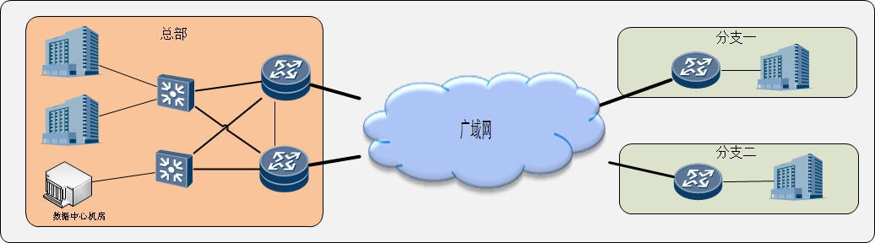
Network Traffic Analysis Requirements: Well-Founded Network Bandwidth Planning
HQ
Branch 1
WAN
Branch 2
DC equipment room
Learn the traffic trend of all branches and proactively discover the devices and branches that require capacity expansion.
IT engineer: "The port bandwidth of the ** device in branch 1 is used up, and new devices need to be purchased for capacity expansion."
Supervisor: "Capacity expansion again? Is the network not completely optimized or are service applications developing rapidly?"
IT engineer: "Here is a detailed network application development report for each branch..."
Analyze the distribution of applications with increasing traffic in branches and identify high-value items for capacity expansion.
Analyze branch traffic changes and properly allocate network resources.

Slide 7
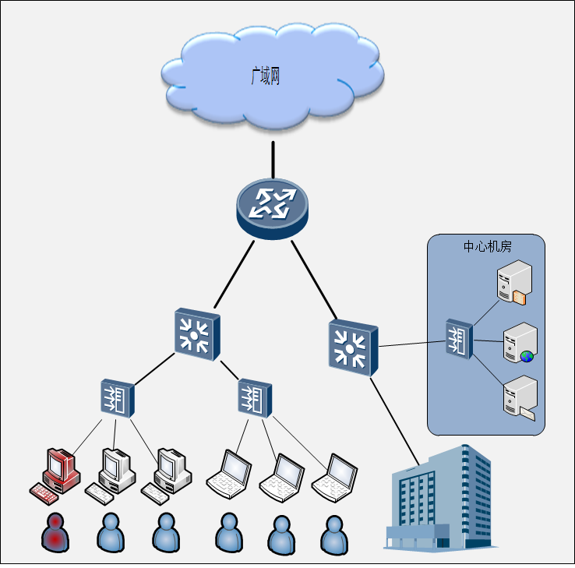
Network Traffic Analysis Requirements: Quick Network Exception Locating
WAN
The interface usage is high, and the network responds slowly. Which IP addresses have high traffic?
Emails cannot be received. Does the email server stop working?
DC equipment room
A high interface usage alarm is reported. What can be done to quickly locate the faulty host that causes the exception?
Applications cannot be accessed normally. Is the server stopped or are hosts consuming the resources on the application server?

Slide 8
1
Network Traffic Analysis Requirements
2
NTA Functions
3
Traffic Configuration
4
Traffic Monitoring
5
Typical Application Scenarios

Slide 9
NTA Functions: Comparison of Common Traffic Statistics Collection Modes
Traffic Statistics Collection Mode | Typical Product | Restriction
SNMP: The NMS uses SNMP to obtain the number of bytes and number of packets from the device MIB and analyzes the device traffic. | MRTG HP OpenView NMS | SNMP can obtain only the number of bytes and number of packets on device ports, but cannot obtain the IP addresses, ports, protocols, and DSCP values of the hosts that send and receive traffic. This mode cannot further analyze traffic based on applications and host sessions.
Packet capture and analysis: The traffic of multiple ports on a device is copied to one of the ports, or hardware at the physical layer (such as an optical splitter) is used to copy the traffic. The PC is connected to the port to use a packet capture tool to analyze the traffic. | Sniffer Pro Wireshark and others | User investment is increased, and device ports are wasted. The traffic bandwidth that can be analyzed is limited by the forwarding capability of the mirrored port. If the traffic bandwidth exceeds the forwarding capability, packets are lost. This mode is not applicable to the ports that cannot be mirrored. In addition, this method cannot easily analyze the traffic on the entire network or historical traffic. This mode can analyze only the current traffic and cannot analyze historical exceptions. The operations are complex.
Flow-based statistics collection: Network devices generate traffic information when they forward data traffic and send the traffic information to the port of the specified IP device in UDP packets. Then, the network traffic analysis software analyzes the traffic. | Major flow protocols NetFlow NetStream sFlow IPFIX J-Flow | This mode depends on device capabilities and can analyze the traffic on the entire network. Users do not need to purchase devices or waste resources.

Slide 10
NTA Functions: Flow-based Statistics Collection
A flow is a unidirectional data packet flow between a source IP address and a destination IP address. Flows have the following common attributes: IP address of the source host, source port, IP address of the destination host, destination port, IP protocol, DSCP, inbound and outbound device interfaces, next hop, tcp_flag, and others. A flow is initialized when a device receives the first IP data packet. All data packets that meet the flow requirements are counted in the number of bytes and number of packets of the flow are increased. Flow information is uploaded in UDP packets for analysis.
Traffic
Flow
Flow
Flow
Flow
Flow
Flow
Flow
Flow
  Source IP address: traffic source
  Destination IP address: traffic destination
  Source port: traffic source
  Destination port: applications for which the traffic is used
  Layer 3 protocol: protocol used for the traffic
  TOS or DSCP: traffic priority
  Input interface: traffic distribution of network devices
  Other IP packet information: tcp_flag, next hop, application ID, and others

Slide 11

NTA Functions: NetStream-based Collection and Traffic Statistics Analysis
Package
eSight NTA
Device traffic
Interface traffic
Application traffic
NetStream
Host traffic
  Source IP address: source host of the traffic
  Destination IP address: destination host of the traffic
  Source port: port of the source host
  Destination port: port of the destination host
  Layer 3 protocol: UDP or TCP
  DSCP: service priority
  Device interface: inbound or outbound device interface
  …
Session traffic
Receives and parses packets reported by various devices, aggregates the original packets, and transfers the aggregated files to the NTA; provides an intelligent traffic analysis data model, stores and analyzes the collected data based on the model, and displays traffic from different dimensions.
NDE
Traffic exporter
The traffic exporter is a network device that exports traffic packets. Examples are Huawei AR and S9700.

Slide 12
1
Network Traffic Analysis Requirements
2
NTA Functions
3
Traffic Configuration
4
Traffic Monitoring
5
Typical Application Scenarios

Slide 13
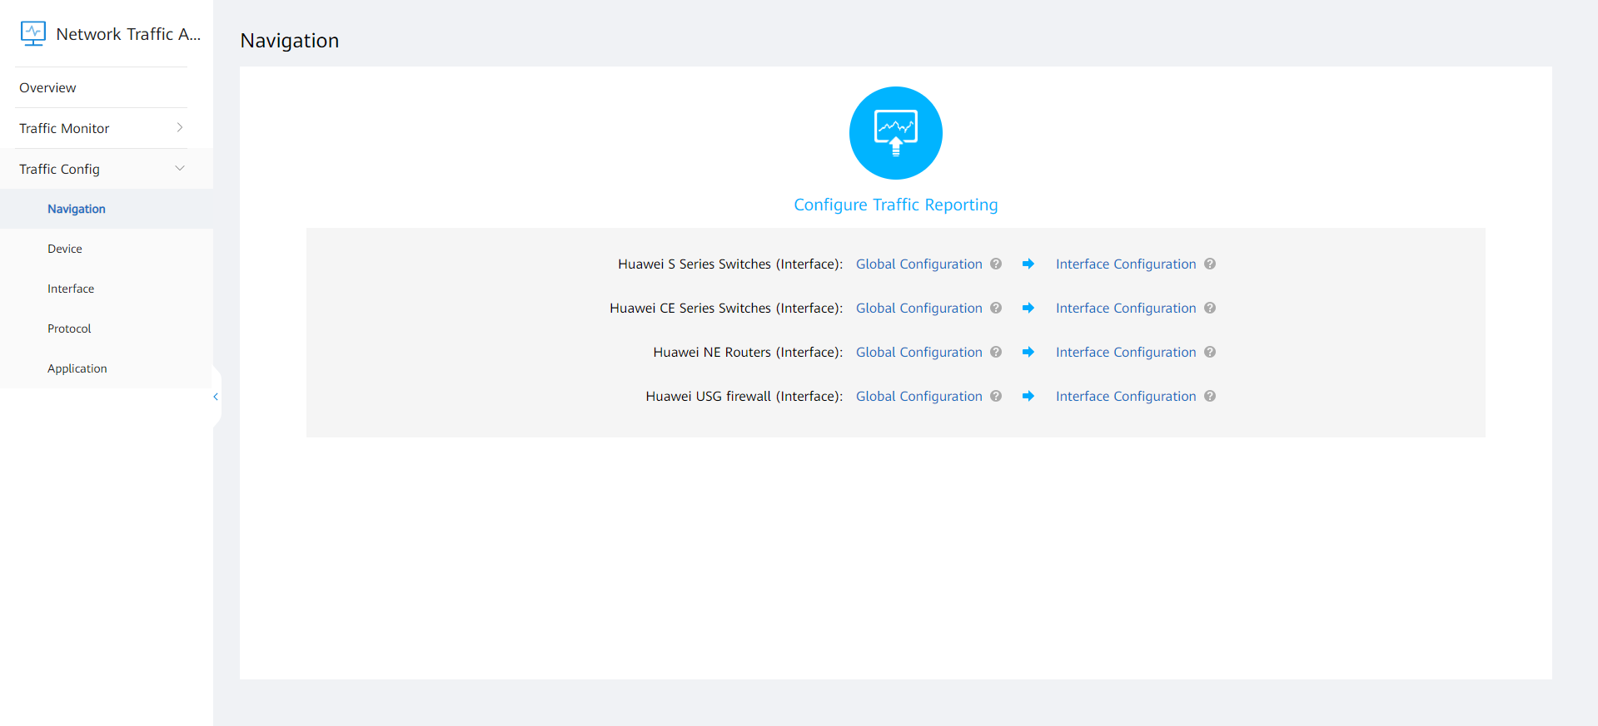
Traffic Configuration: Configuration Navigation
A configuration navigation page is provided to guide users to configure basic device information.
Various devices are supported, including S series switches, CEs, routers, and firewalls.

Slide 14
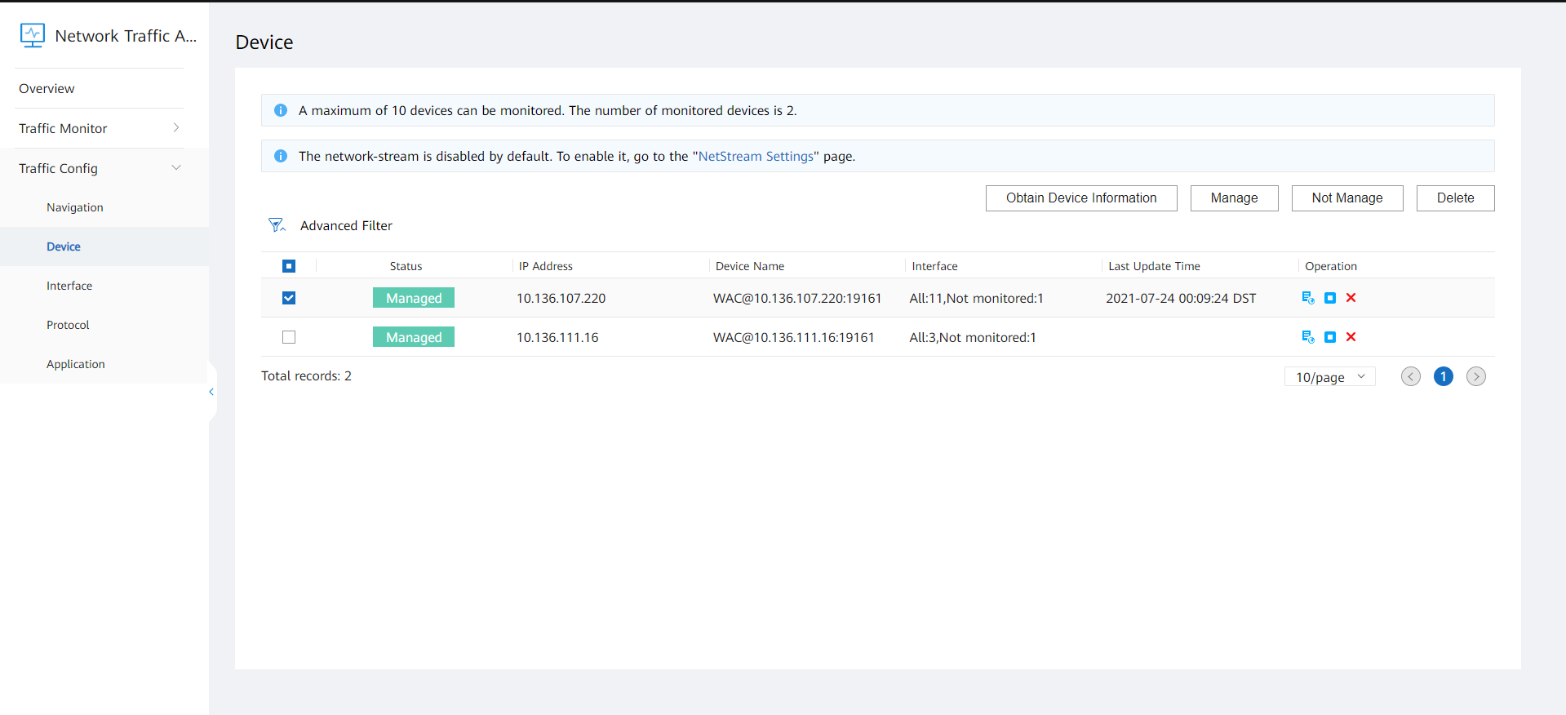
Traffic Configuration: Device Management
Devices and interfaces are automatically added. The status of automatic adding is displayed in the list.
You can click Obtain Device Information to obtain the latest device and interface information.
You can unmanage unauthorized devices. The NTA does not process traffic data reported by unmanaged devices.

Slide 15
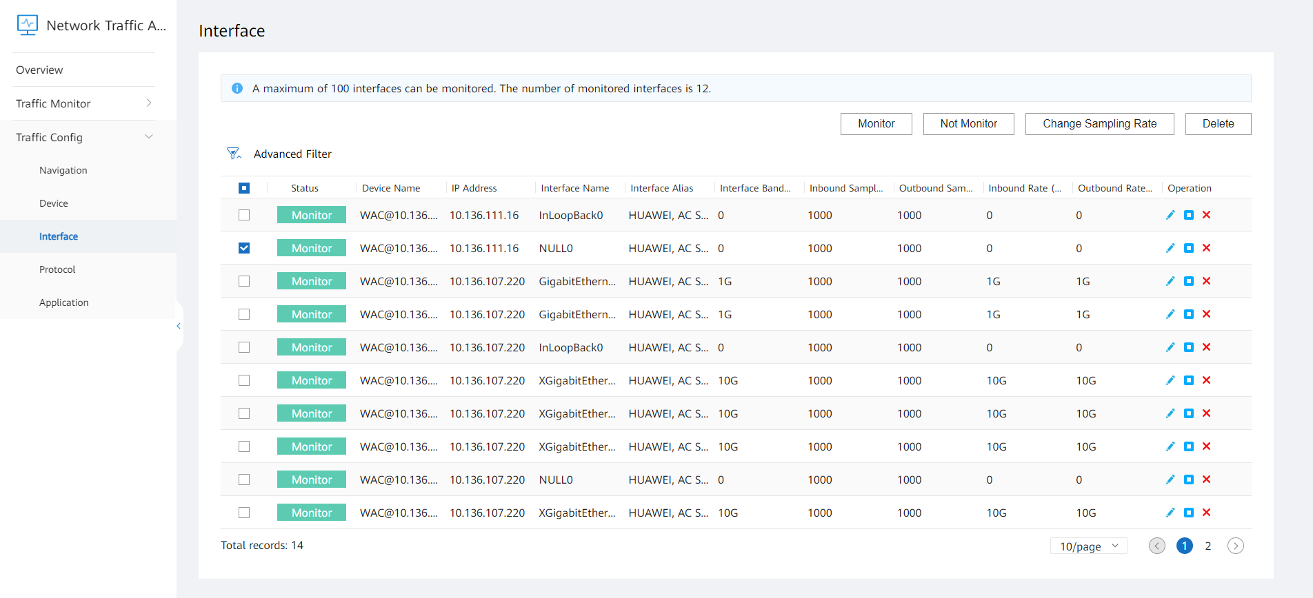
Traffic Configuration: Interface Management
You can configure the interface rate and sampling rate based on the device configurations.

Slide 16
1
Network Traffic Analysis Requirements
2
NTA Functions
3
Traffic Configuration
4
Traffic Monitoring
5
Typical Application Scenarios

Slide 17
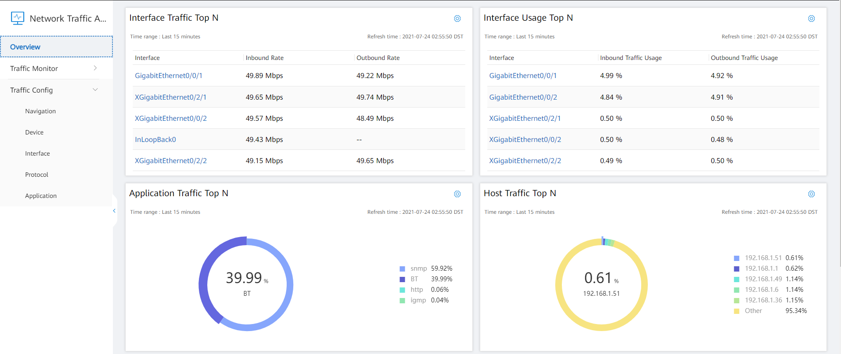
Traffic Monitoring: Overview
Statuses and application information on the entire network are displayed in real time.

Slide 18
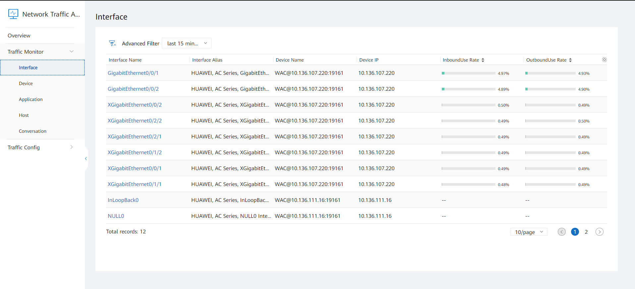
Traffic Monitoring: Interface
All interfaces that are monitored on the entire network are displayed in a list.
You can query or rank interfaces by KPI in ascending or descending order in the list.
You can click an interface to view traffic details.

Slide 19
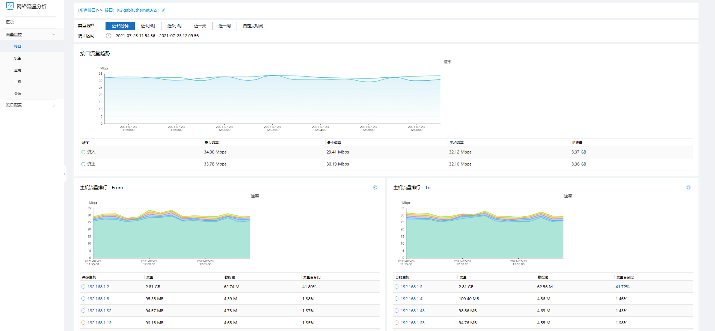
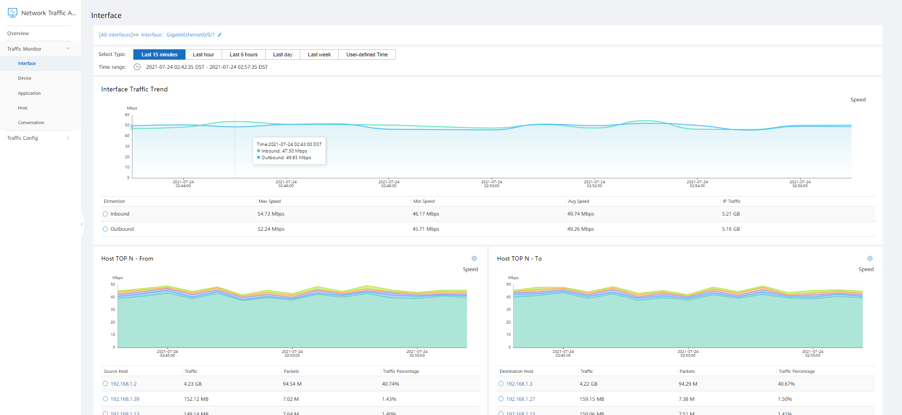
Traffic Monitoring: In-depth Analysis of a Single Interface
The upper part displays the traffic trend line chart. You can view the traffic trend within a specified period.
The lower part displays traffic details, including top N hosts, top N applications, and top N sessions.
Traffic information can be filtered by user-defined time.
In-depth data analysis is supported. You can click a traffic chart to view traffic details.

Slide 20
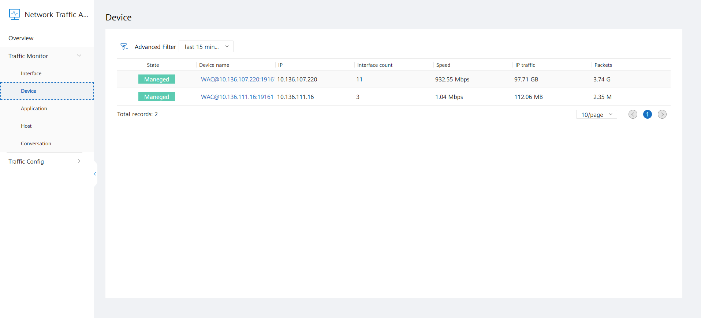
Traffic Monitoring: Device
View the number of interfaces and traffic statistics on monitored devices.

Slide 21
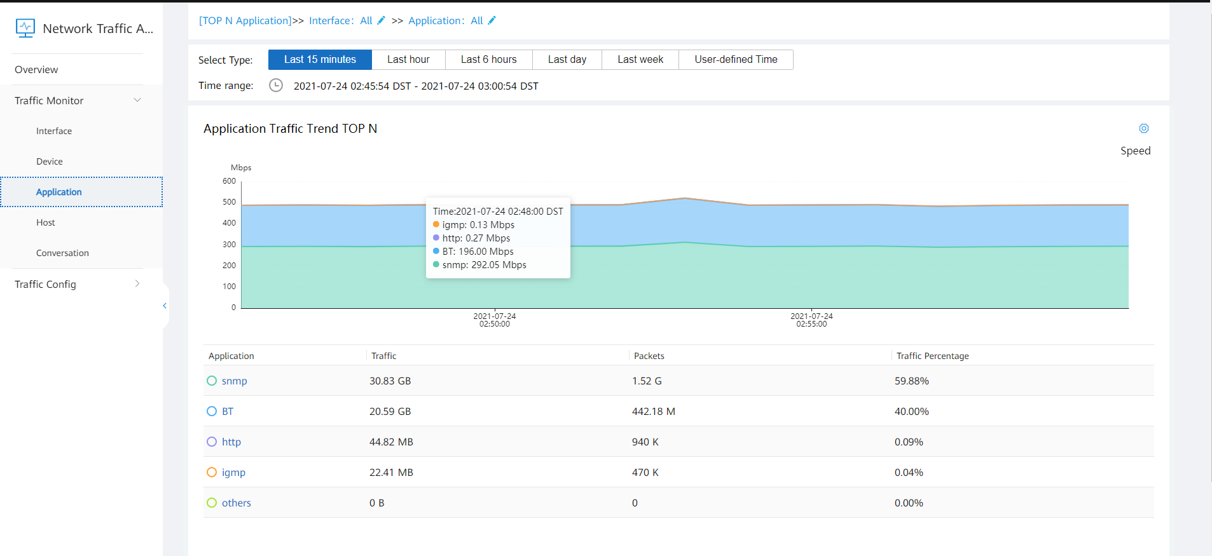
Traffic Monitoring: Application
The upper part is the stack area chart of application traffic, and the lower part is the application traffic list. Application traffic can be filtered by user-defined time in the list.
In-depth data analysis is supported. You can view the traffic distribution of specific applications.

Slide 22
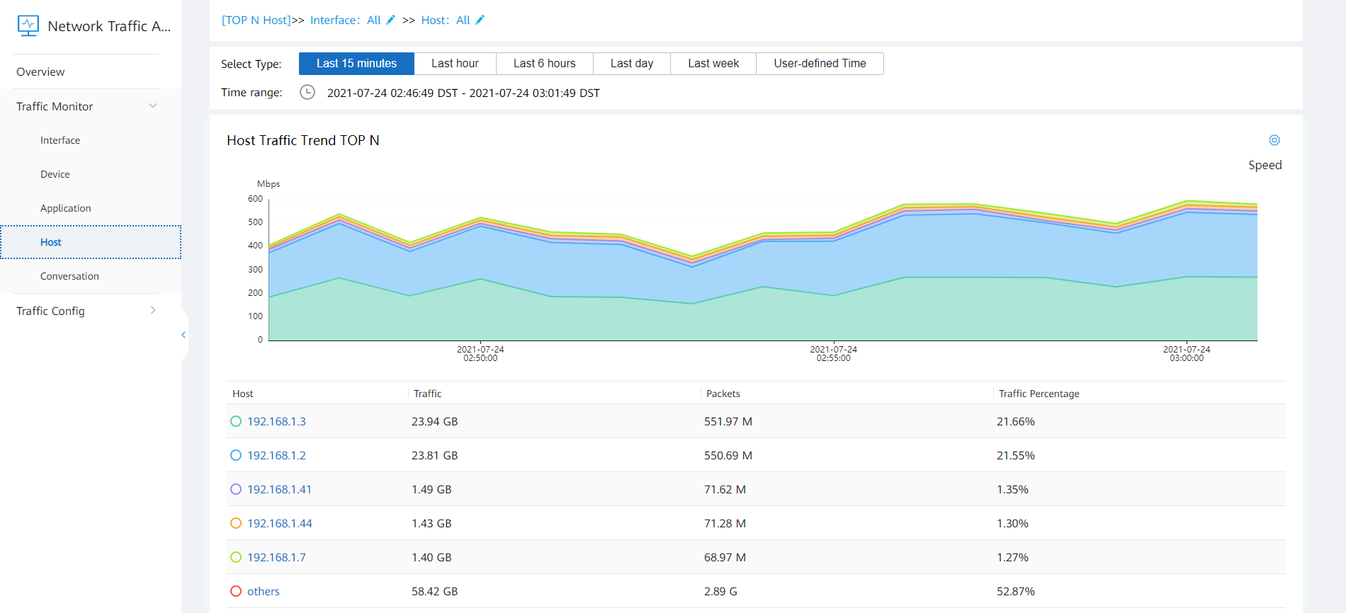
Traffic Monitoring: Host
View the top N traffic distribution of all hosts, source hosts, and destination hosts.
In-depth data analysis is supported. You can view the traffic distribution of specific hosts and analyze the causes of abnormal host traffic.

Slide 23
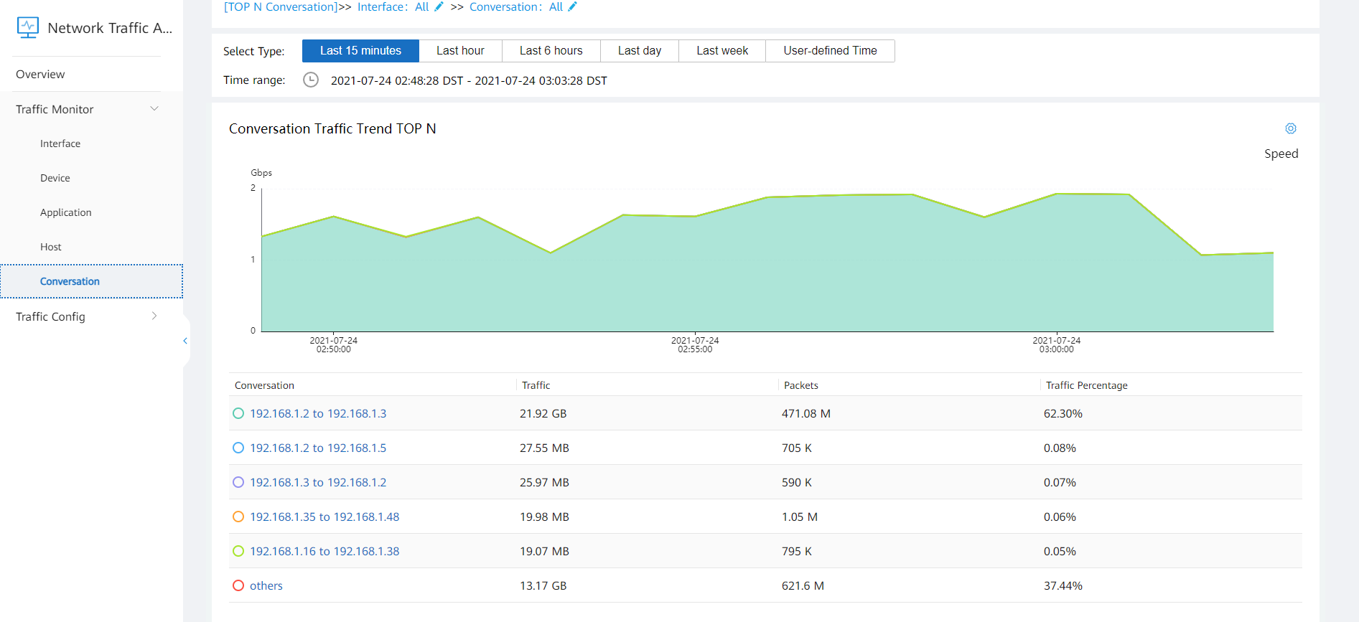
Traffic Monitoring: Session
The upper part is the stack area chart of session traffic, and the lower part is the session traffic list. Session traffic can be filtered by user-defined time in the list.
In-depth traffic analysis is supported. You can view the traffic distribution of specific sessions.

Slide 24
1
Network Traffic Analysis Requirements
2
NTA Functions
3
Traffic Configuration
4
Traffic Monitoring
5
Typical Application Scenarios

Slide 25
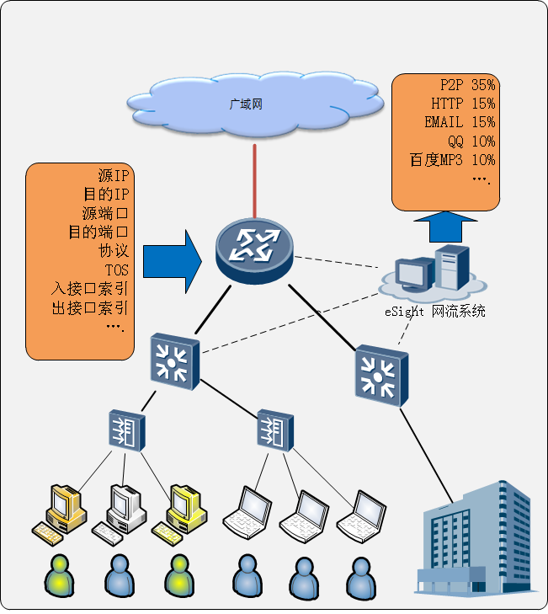
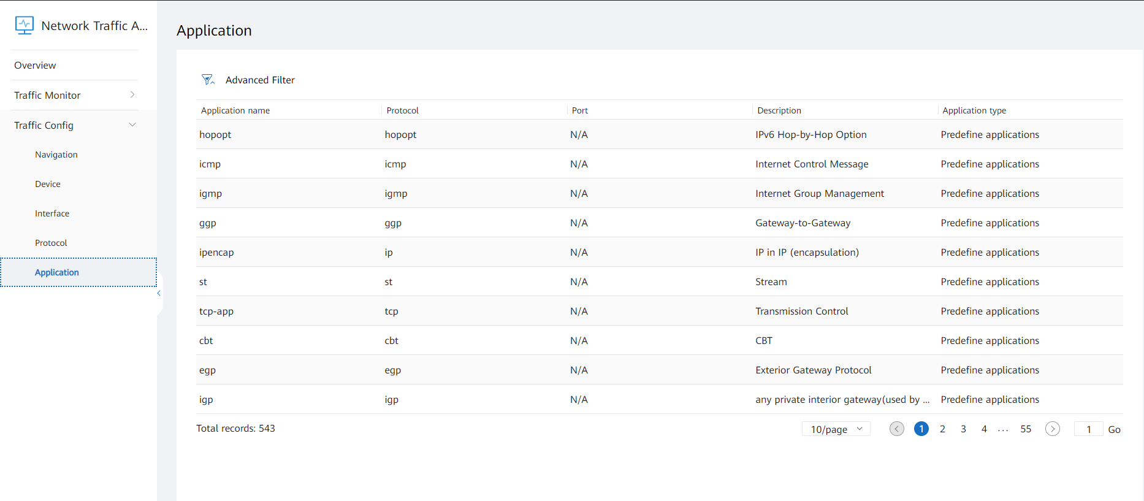

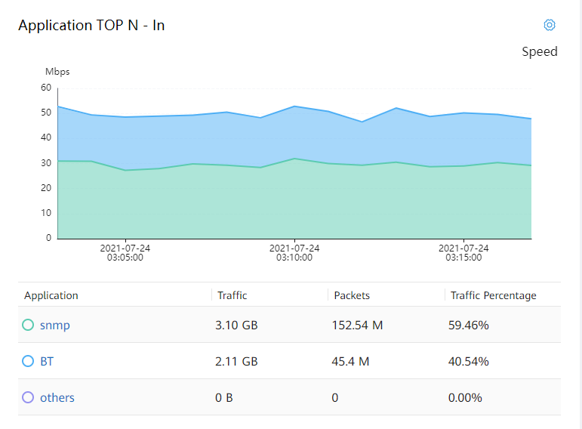
Application Scenario 1: Visualized and Controllable Application Bandwidth
1
The system can work with AR routers to automatically identify over 1800 types of network applications.
WAN
FTP
Source IP
Destination IP
Source port
Destination port
Protocol
TOS
…
2
Open the device or interface traffic analysis page, check the application traffic to determine whether the bandwidth is occupied by applications and analyze restriction policies.
eSight NTA
Configuration method:
Enable NetStream in the inbound and outbound directions of uplink interfaces or in the inbound direction of uplink and downlink interfaces on egress devices, and send traffic to the eSight NTC.
3
Apply the packet discarding or rate limit policies for applications with improper bandwidth usage to interfaces.

Slide 26
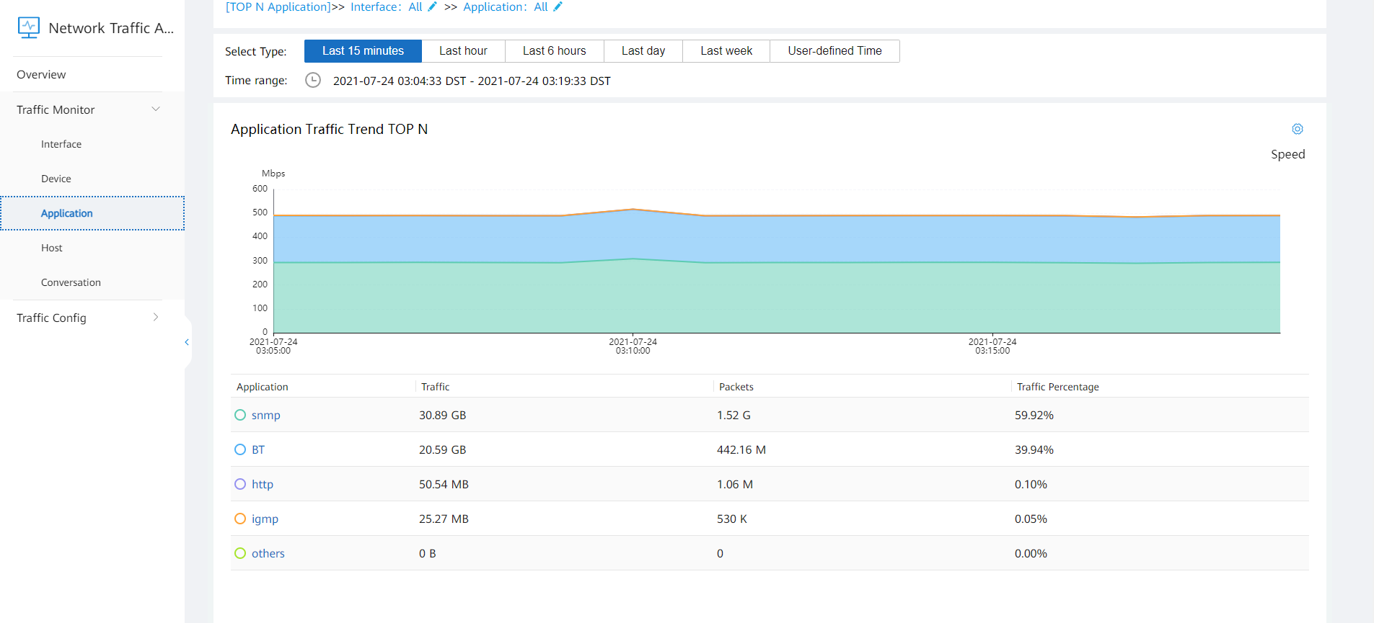
Application Scenario 2: Expanding Campus Branch Link Bandwidth
HQ
Branch 1
WAN
Branch 2
DC equipment room
View the application traffic usage within a specified period. If bandwidth is properly used by applications and the application traffic usage remains high for a long time, capacity expansion can be performed.

Slide 27
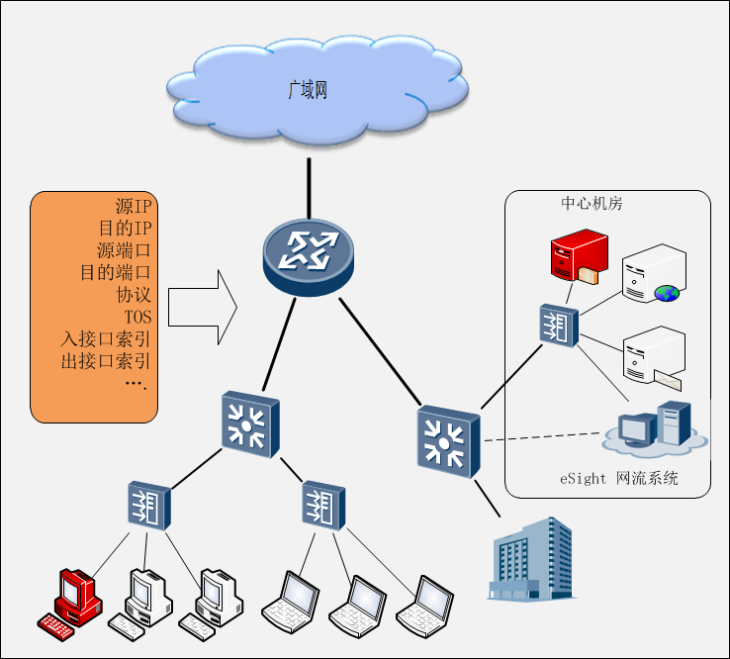
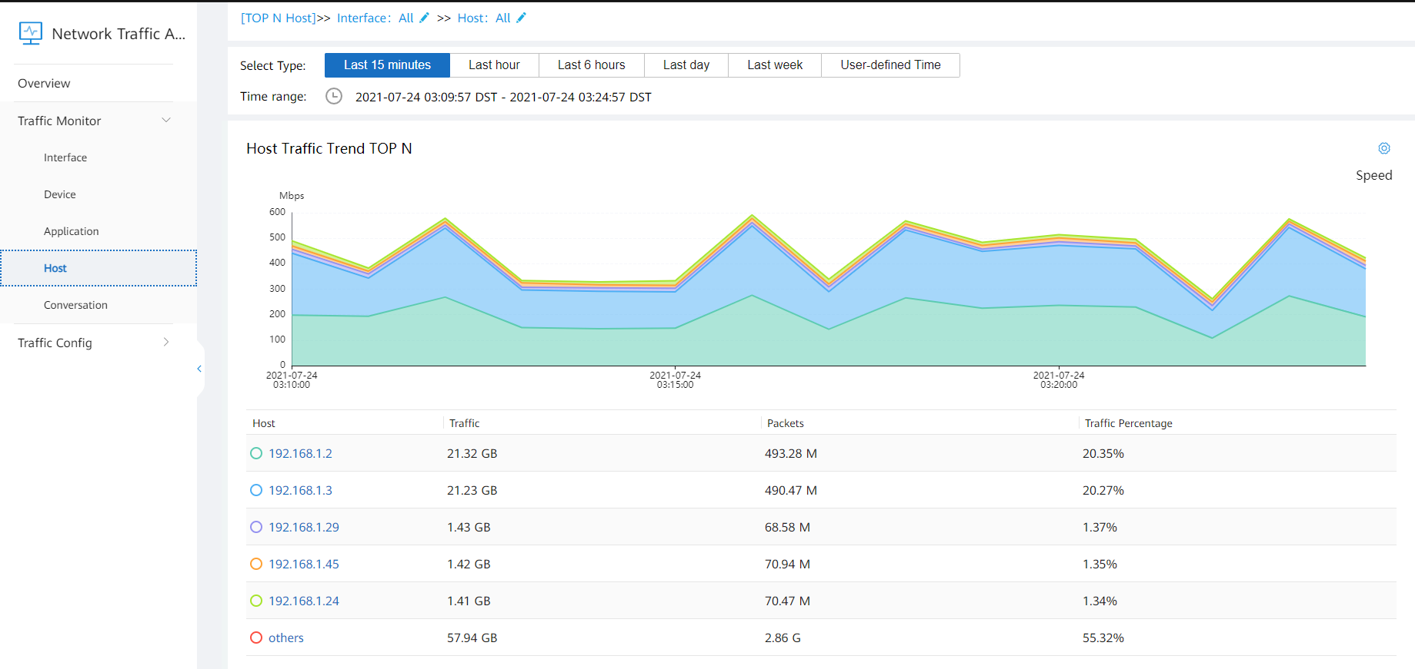
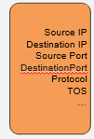

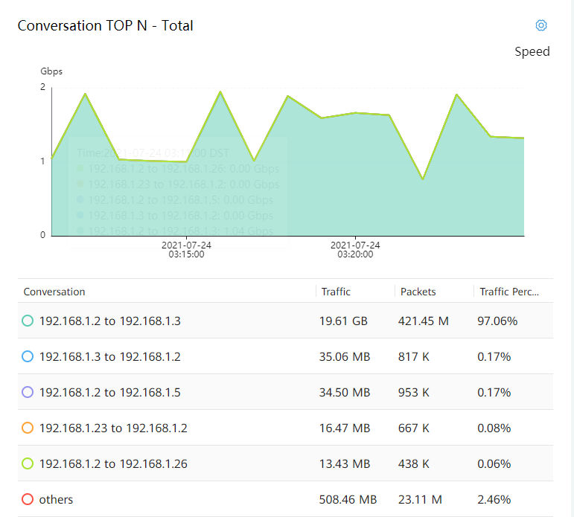
Application Scenario 3: Locating Application Server Access Exceptions in DCs
1
View the host traffic and identify abnormal traffic of specific application servers.
WAN
Source IP address
Destination IP address
Source port
Destination port
Protocol
TOS
...
Central equipment room
2
Open the host traffic details analysis page and view the session traffic of the host.
NTA
Configuration method:
Enable NetStream in the inbound and outbound directions of uplink interfaces or in the inbound direction of uplink and downlink interfaces on egress devices, and send traffic to the eSight NTC.
3
If a few sessions consume most traffic, the host specified by the source IP address consumes application server resources, and network attacks may occur.

